Slide 1
Cogent Lecture 2
Logging responses etc.
Designing psychological experiments in
MATLAB using Cogent toolboxes
Rebecca Lawson
30th Nov 2017
Course Material: http://www.icn.ucl.ac.uk/
Cogent Software: http://www.vislab.ucl.ac.uk/cogent.php

Slide 2
Autumn/Winter Term – Cogent
2:00pm Thurs 23rd Nov An introduction to Cogent 2000
2:00pm Thurs 30th Nov Logging responses, script logic etc.
2:00pm Thurs 7th Dec Cogent Graphics and external devices
10:00am Mon 4st Dec Practical 1 – Cogent 2000
10:00am Mon 11th Dec Practical 2 – Cogent Graphics
Course Materials
https://www.ucl.ac.uk/icn/study/matlab-course/index

Slide 3
Aims
Become competent in Cogent (i.e., self-sustaining)
Organising an experimental script
How to configure Cogent prior to starting an experiment
How to present a:
String
Image
Sound
Making a trial loop
Randomising stimulus presentation
Presenting multiple stimuli in different locations on the screen
Recording of experimental variables (e.g., stimulus time; location etc.) from trial to trial
Collecting and recording key-presses
Making presentation contingent on key-presses
Turn your experimental script into a function
Thinking logically about experimental scripts

Slide 4
Recap of last week
Creating empty variables and structures that you are going to call later on in the script so that you avoid hard coded values e.g.
p. numtrials=40;
p.times.stim=1000;
p.times.fixation=500;
p.times.blank=2000;
p.stim={‘image.bmp’};
etc.
This involves MATLAB programming skills and a bit of thought and isn’t anything specific to Cogent.
Initialising expt. variables
Initialising expt. variables
Configuration of devices
start_cogent
Run experiment
load premade stimulus files
create new stimuli
trial loop:
- present stimuli
- get user responses
- save data as you go
save final data & close files
stop_cogent
Notes:
We start by first initializing all the variables that we are going to need later on in the script. I personally use a structure which I call P for parameters, and in t here I store things like the number of the timing information for different parts of my trial and filenames or paths to the stimuli that I want to present.

Slide 5
Recap of last week
Configure all devices required before you start_cogent
config_display;
config_sound;
config_keyboard;
config_mouse;
config_serial;
config_log;
config_data;
config_results;
To find out more about a config function type: help config_xxx
Initialising expt. variables
Configuration of devices
start_cogent
Run experiment
load premade stimulus files
create new stimuli
trial loop:
- present stimuli
- get user responses
- save data as you go
save final data & close files
stop_cogent
Notes:
Then we need to configure any peripheral devices that you want cogent to be able to interact with using these config commands. Written as they are here they will use the default settings. Details of what the defaults are for each configuration can be found by typing help config_ whatetver. This information is also in the manual.

Slide 6
Recap of last week
Help config_display
Usage:
config_display
config_display( mode, resolution, background, foreground, fontname, fontsize, nbuffers, number_of_bits, scale )
Arguments:
mode - window mode ( 0=window, 1=full screen )
resolution - screen resolution (1=640x480, 2=800x600, 3=1024x768, 4=1152x864, 5=1280x1024, 6=1600x1200)
background - background colour ( [reg,green,blue] or palette index )
foreground - foreground colour ( [reg,green,blue] or palette index )
fontname - name of font,
fontsize - size of font,
number_of_buffers - number of offscreen buffers
number_of_bits - number of bits per pixel (8=palette mode, 16, 24, 32 or 0=Direct mode, maximum possible bits per pixel)
scale - horizontal size of screen in (visual degrees)
e.g. config_display( 0, 2, [0 0 0], [1 1 1], 'Arial', 25, 4 )
Initialising expt. variables
Configuration of devices
start_cogent
Run experiment
load premade stimulus files
create new stimuli
trial loop:
- present stimuli
- get user responses
- save data as you go
save final data & close files
stop_cogent
Notes:
Once you know the different arguments that each call to configure takes you can change the defaults to suit your experiment. E.g. ….

Slide 7
Recap of last week
Start cogent after config_ but before stimuli created/presented
start_cogent
Initialising expt. variables
Configuration of devices
start_cogent
Run experiment
load premade stimulus files
create new stimuli
trial loop:
- present stimuli
- get user responses
- save data as you go
save final data & close files
Stop cogent after all stimuli end, responses logged & data saved
stop_cogent
stop_cogent
Notes:
Then after you’ve configured the devices, and also at the very end of the script you need start_cogent and stop_cogent. These don’t have any arguments, they are just as they are.

Slide 8
Recap of last week
Initialising expt. variables
Configuration of devices
start_cogent
Cogent 2000 commands
Run experiment
load premade stimulus files
create new stimuli
trial loop:
- present stimuli
- get user responses
- save data as you go
save final data & close files
‘preparestring(text, buffer, x, y)’
‘loadpict(filename, buffer, x, y)’
‘loadsound(filename, buffer)’
‘drawpict(buffer)’
‘playsound(filename, buffer)’
‘wait(time)’
‘waituntil(time)’
stop_cogent
Notes:
Then we went over how you actually construct a trial structure, within a loop, using the cogent 2000 commands to first prepare, or load, different types of stimuli into numbered offscreen memory buffers…. And the then present those buffers using drawpict (in the case of text and bitmaps), playsound (in the case of sounds) and using wait comments to control how long each element of the trial lasts for. The “time” argument in each case is going to be a p.times variable, previously set at the beginning of the script.

Slide 9
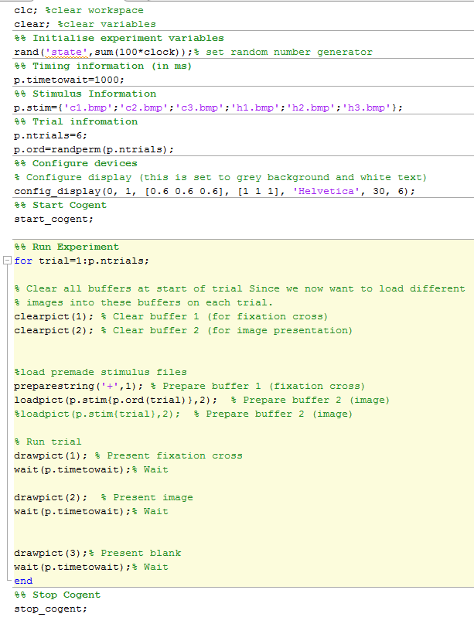
Recap of last week
Initialising expt. variables
Initialising expt. variables
Configuration of devices
Configuration of devices
start_cogent
start_cogent
Run experiment
- trial loop:
load premade stimulus files
create new stimuli
- present stimuli
- get user responses
- save data as you go
save final data & close files
stop_cogent
stop_cogent
Notes:
So we have a simple script that effectively makes a list of stimuli (in our case, the list contains the names of images we want to present), muddles that list into a random order (we went over two way to do that last week), then loops down the list, presenting each image in turn as part of a trial structure. In this case the trial structure is a fixation cross, followed by and image, followed by a blank.

Slide 10
First full experiment
Hypotheses: People think theTories are just as bad as the Baddies from Star Wars and People implicitly associate high up things with heaven (goodness) and low down things with hell (badness).
Task: Show people images of Baddies and images of Tories, either high up on the screen or low down on the screen, and measure their reaction time to categorise them as Baddies or Tories.
Experimental predictions:
Participants will be slower to respond to images of Tories, relative to images of the baddies from Star Wars, (e.g. an interference effect).
Participants will be faster to respond ‘baddie’ when images are presented at the bottom of the screen relative to the top of the screen (e.g. a congruency effect).
- Imagine you don’t hypothesise any effects on accuracy, so you want to give people feedback after each response about whether they were correct or not so that you keep them as accurate as possible.
Notes:
That was really a toy example to go over how to construct a basic experiment structure. Now we want to take that toy skeleton structure and add in all the extra code that we need to fun a full experiment that addresses some actual hypotheses. Every good experiment should start with at least one hypothesis, and in our case we have two.
So baddies are baddies, Tories are Tories, but since Tories are also (arguably) baddies, it will take longer for you to decide when you have to respond to image of Tories.
Second, irrespective of image type, high up things remind us of heaven, and low down things remind us of hell, so since the Tories and the Baddies are all sort of bad, we will be faster to respond to images on the bottom of the screen (congruency) relative to the top of the screen (incongruency).

Slide 11

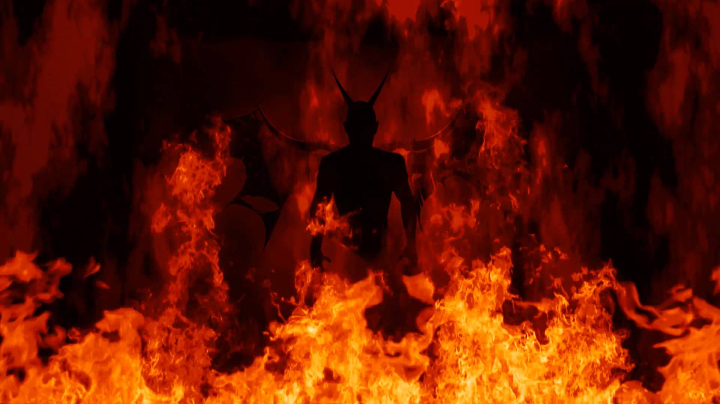


First full experiment
Position On Screen
Top (heaven)
Bottom (hell)
Baddie
ET | EB
TT | TB
Image Type
Tory
Notes:
To break that down graphically, we have a 2x2 design with factors of position on screen and image type, each with two levels. The main effect of image type is going to address hypothesis one.

Slide 12
First full experiment
Position On Screen
Top (heaven)
Bottom (hell)
Empire
ET | EB
TT | TB
Image Type
Tory
Notes:
And the main effect of position is going to address hypothesis two. And I suppose you might also be interested in the interaction effect.

Slide 13
First full experiment
We need to:
Change the position of the images on the screen (half on top, half on bottom, equal numbers of each image type).
Collect subject responses, work out reaction time (hypotheses are about speed of response), work out if they were correct or not and give feedback contingent on correctness.
Log information about each trial (e.g. type, position, reaction time, accuracy) into variables that you can use for analysis.
Save the data so that you can access it later for analysis.
Turn the script into a function, with the subject ID as the input.
Give participants instructions on the screen before the experiment starts.
Notes:
So we need to take the script we were working with last week and make the following changes…. And we’re going to go over how to do each of these things for the rest of the time today.

Slide 14
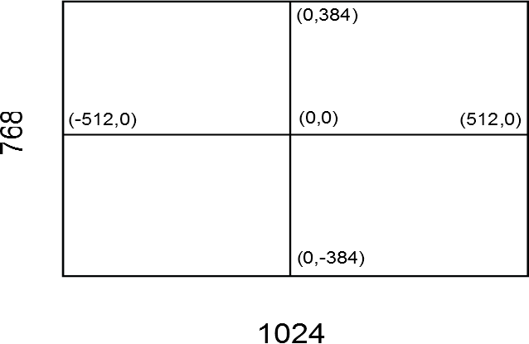
Presenting stimuli in different locations
preparestring(text, buffer, x, y); loadpict(filename, buffer, x, y);
Notes:
First of all, presenting stimuli in different location is actually quite straightforward. We do this using the prepare and load commands. In addition to the buffer argument, where you assign a buffer to load the stimulus on to, there are also two further arguments that represent the X and Y position on the screen. Cogent uses this coordinate system to represent different parts of the screen, where 0,0 is the middle. So if your screen resolution was 768x1024 then the top right corner left corner would be -512, 384 etc.
But remember that we don’t want ALL the stimuli to appear in the same position, we need half to be presented up here and half down here. That means that loadpict needs to exist inside an if loop where we say, if stimpos=up, x and y are 0, 250 else if stimpos = down, x and y and 0, -250.

Slide 15
Example 6: changing stimulus position
Notes:
And now an example of how to do that.

Slide 16
Collecting and recording key-presses
Now let’s collect some behavioural data
Task: ‘Baddie or Tory?’
Add string before picture presentation to remind participant of task.
The functions:
‘clearkeys’ % clears all keyboard events
stimonset= drawpict(buffer) % time stamps when image was presented
‘readkeys’ % reads all key-presses since clearkeys
‘[key, t, n] = getkeydown’ % returns key IDs for all keypresses read by last ‘readkeys’
Or ‘[key, time, n] = waitkeydown(dur, key)’ – waits for keypress until specified length of time
Also: ‘getkeyup’ ‘waitkeyup’ (i.e., when they release the key rather than pressed it).
Notes:
Ok, now we want to collect some keypresses. First lets introduce the new commands that will enable us to do this.
We’ll need to use clearkeys; this clears all the keyboard events that have happened up until its called. Then, because we want to calculate RTs we need to timestamp when the image is actually presented. All we need to do is assign a variable name to the drawpict command and that variable will take the value of the time the image was presented. Then we after that we need to readkeys; this reads any key presses since the last call to clearkeys. Getkeydown is going to look for any down keypresses and it’s going to output three new variables. Which key was pressed, what time it was pressed and how many times.
Alternatively if you want to leave the image on the screen until they press a button, you would use waitgetdown (instead of getkeydown). This command outputs the same variables,but has two input arguments, (duration and key ID).
These commands concern key presses but you can also look at key releases if you want.

Slide 17
Working out RTs and logging data
To calculate Reaction Times:
- The time they responded (i.e. t(1)) minus the time the
image was presented (i.e. stimonset).
rt= t(1)-stimonset;
Logging responses in the results structure:
results.image(trial,2)=p.randstim(trial,2); % image type
results.resp(trial,1) =key(1); % key pressed
results.rt(trial,2) = rt; % reaction time
Notes:
So, to calculate RTs we take the variable that stores the time they responded (that’s the t, output from getkeydown) and subtract from it the time that the stimlulus was presented (that’s the stimonset variable that holds the timestamp for when drawpict was executed. We name this a new variable called RT.
Finally, since we want to do analysis on this data and these variables (stimonset, k, t, n) are going to update on every iteration of the trial loop, we need to save these variables on each iteration into a results log. I use a structure called results. In here we store any infotmation about that trial that we need for analysis. So, e.g.. What image type was presented, whether it was presented at the top or bottom, what key they pressed and their RT.

Slide 18
Example 7: keypresses, reaction times etc.
Notes:
Now let’s look at the code to implement this.

Slide 19
Making presentation contingent on key-presses
What if you only want to present a stimulus if the participant presses a specific button? e.g. to present feedback on performance.
map=getkeymap; % saves all the key IDs to a
variable called map
Use if/elseif to control what stimuli you show dependent on keyIDs. i.e. to give feedback on performance
e.g.:
if key(1) = 2; % keyID for ‘b’ key in Cogent
DO SOMETHING
elseif key(1) = 20 % keyID for ‘t’ key in Cogent
DO SOMETHING DIFFERENT
end
i.e. we will use preparepuretone(frequency,duration,buffer); to present auditory feedback to the participant.
Notes:
OK, now we said we want to provide feedback about whether or not they were right or wrong after they have made their response. Not surprisingly this will involve looking at their response (baddie/tory) - key ID they pressed, checking it against the image type that was presented (baddie or tory) and then using an if loop to say if keyID is this and also image type is this, then give them the feedback for correct, otherwise….. Give them the feedback for incorrect.

Slide 20
SOUND: creating & present stimuli
Load & create stimuli
loadsound(‘fname.wav’,buffer)
preparepuretone(freq,dur,buffer)
freq = pitch of tone (Hz), dur = duration (ms)
preparewhitenoise(dur,buffer)
dur = duration (ms)
preparesound(array,buffer)
array = nsamples * nchannels (1=mono, 2=stereo)
Present stimuli
playsound(buffer)
loopsound(buffer)
repeats continuously
waitsound(buffer)
waits until sound ended
stopsound(buffer)
Notes:
In this case we’re going to generate high and low pitched tones for correct and incorrect and put them into different buffers. Last week we loaded a .wav file but preparepuretone is a very handy cogent function that lets you generate beeps of different frequencies (pitches) and durations (in ms) and load them straight into buffers.
If they were correct we’ll use playsound to play the buffer with the high pitched tone. If they were incorrect we’ll play the buffer with the low pithched tone.

Slide 21
Example 8: work out accuracy, add feedback
Notes:
Ok. Implementation.

Slide 22
Finishing touches – almost a full experiment!
Turning your script into a function allows you to set certain variables when running the script. e.g.:
Participant number
Counterbalancing order
experiment(‘subjectID’)
You can then e.g., define your results filename based the subject number: p.sub=subjectID;
Save the p and results structures
save(p.sub, 'p', 'results');
Put some instructions at the very beginning before
the trial loop starts e.g.
preparestring(‘Instructions',1,x,y);
drawpict(1); % present buffer 1
waitkeydown(Inf);
Notes:
Ok, so we’re almost there now. Just to a few final things to polish this off into a fully fledged script.
We can make it into a function, that takes a subject ID as input. Then we want to save our data as a .mat file named according to the subject ID. And in this case our ‘data’ is two structures p and results.
And finally, before the trial loop even begins we probably want to give the participant some instructions so they know what do do and what buttons to press. So we’ll prepare some text into buffers, present the text and then to give them time to read it we’ll wait forever (inf) untio they make a key press using waitkeydown.

Slide 23
First full experiment
First full experiment!

Slide 24
Interim summary
Some tips:
Start simple and gradually make more complex
Comment everything – don’t assume you will remember what the script does the next time you look at it
Try and define all variables at the beginning of the script (or previously saved in a .mat file)
Get your hands dirty – the based way to learn is to code
Use the ‘help’ command, or type ‘edit FUNCTION’ to see the raw code for a specific function
Try to solve a problem yourself – if you figure it out your knowledge will improve more than if someone tells you how to do it
If you really can’t figure it out, ask someone – if they tell you your knowledge will improve more than if you don’t ask and never solve the problem

Slide 25
Extra Stuff….

Slide 26
Designing an experiment
Think through what you need to do
Make a flow diagram, helps compartmentalise script
Use nested loops to repeat operations
Use logic to make rules

Slide 27
Experimental Design: playatune.m
- Create 8 tones with different pitches and durations.
- Present 4 sequences containing 6/7 tones. Wait 20ms before each tone. Repeat the last tone in session 3 until any button is pressed. Wait 100ms between sequences
Specify variables:
Pitch & duration of 8 tones
4 sequences orders of 6 or 7
pre-tone interval = 20ms
inter-sequence interval = 100ms
Loop round 6/7 tones in sequence
- wait pre-tone interval (20ms)
- play tone
Is it session 3?
Y/N
Create tones
Repeat sound
until keypress
Wait intersequence
interval

Slide 28
Experimental Design: playatune.m
for s = 1:4;
for t = 1:6;
wait(int_tone);
playsound(t);
waitsound(t);
end;
if s == 3;
loopsound(t);
waitkeydown(inf);
stopsound(t);
end;
wait(int_seq);
end;
Loop round each sequence
Loop round 6/7 tones in sequence
- wait pre-tone interval (20ms)
- play tone
- wait until tone ends
Determine if it is session 3. If yes:
- repeat last sound
- wait until a button is pressed
- stop sound
wait intersequence interval

Slide 29
Experimental Design: playatune.m
for s = 1:4;
for t = 1:6;
wait(int_tone);
playsound(t);
waitsound(t);
end;
if s == 3;
loopsound(t);
waitkeydown(inf);
stopsound(t);
end;
wait(int_seq);
end;
Loop round each sequence
Loop round 6/7 tones in sequence
- wait pre-tone interval (20ms)
- play tone
- wait until tone ends
Determine if it is session 3. If yes:
- repeat last sound
- wait until a button is pressed
- stop sound
wait intersequence interval

